Slide 1
SMART Home
Group 2:
John Satterla – Computer Engineer – Wireless Connectivity
Zachary Eakerns [Team Lead] – Electrical Engineer – Biomedical Station
Zarka McClung – Computer Engineer – Facial Recognition
Christian Jensen – Electrical Engineer – Voice Recognition

Slide 2

Last Week's Deliverables
John Satterla
Zachary Eakerns
Zarka McClung
Christian Jensen
Have working location tracking
Determine all Zigbee protocol commands
Begin integrating and building out GUI
Have python graphing the ADC in real time
Make headway on circuit instability
Write Python code to send serial communication to Zigbee
Establish motor code upon signal from Zigbee co-ordinator
Finish green board design
Continue writing Matlab code for voice recognition
-25tor SM-42BYG011-25
-25tor SM-42BYG011-25

Slide 3
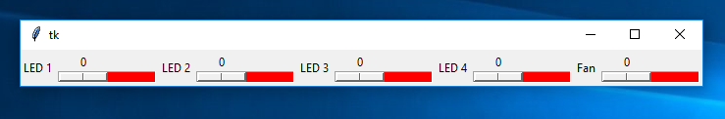
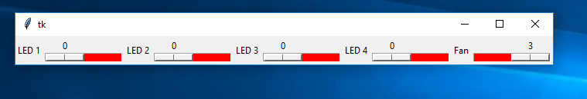
Graphical User Interface – Updates and Control of Devices
Added sliders for LED’s that are on and off only, Fan has 4 speeds including off. Each slider is dynamic (reacts to network), for instance if the location tracking turns on an LED the slider will reflect that. (program on next slides)
Need to work on controlling computer fan w/ MSP (will need transistor circuit), and work on interfacing LCD and servo. Would like to include some type of temperature detection for automatic fan control

Slide 4
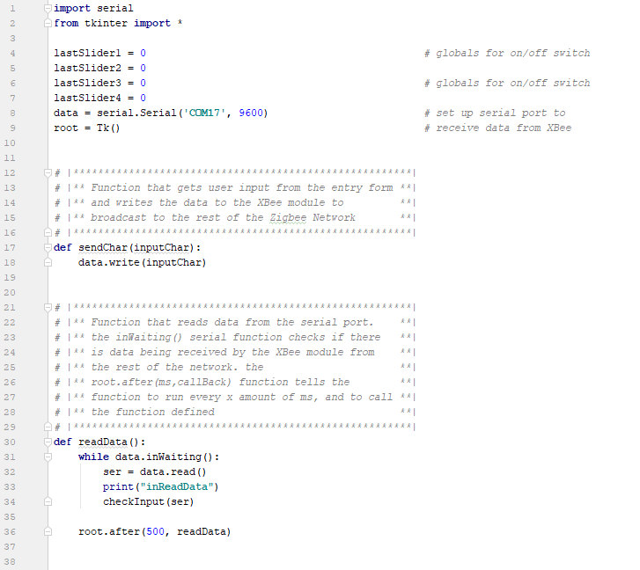
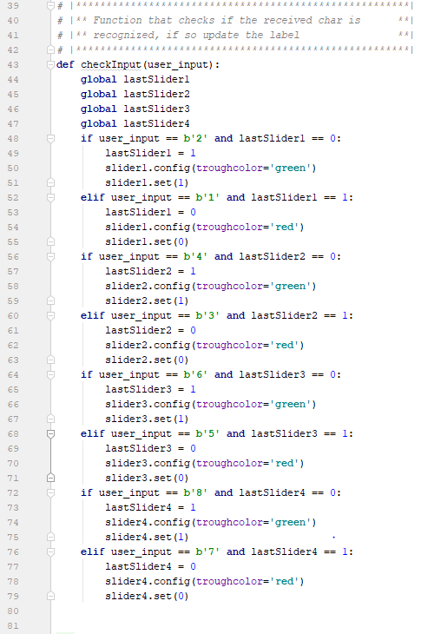
Graphical User Interface – More Development
Using Python 3, with tkinter as GUI, and pyserial for communication to USB dongle with Xbee module

Slide 5
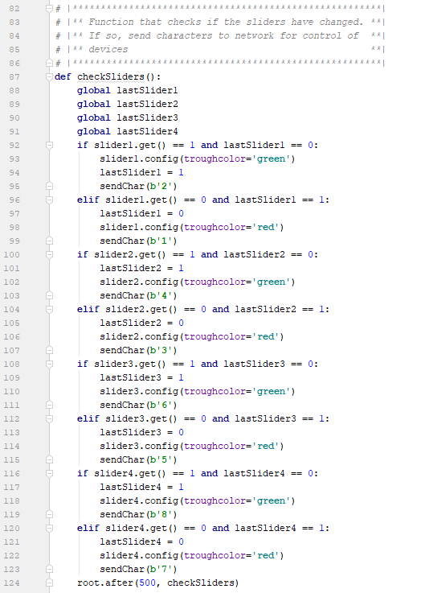
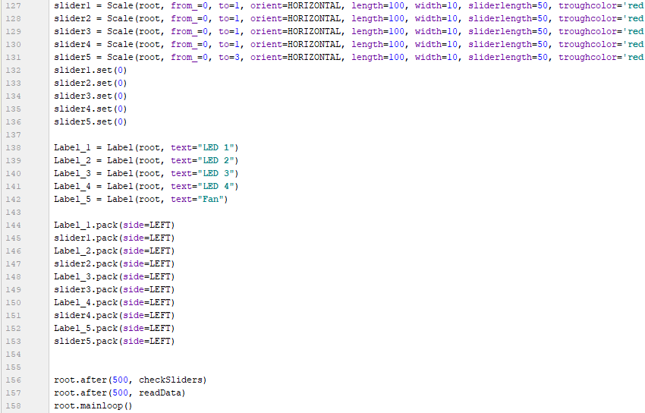
Graphical User Interface – Early Development
Using Python 3, with tkinter as GUI, and pyserial for communication to USB dongle with Xbee module

Slide 6
Updates on Location Detection
TI got back to me, they had me change the setting I was using.
Now, instead of using the “Auto ToF” mode, using “Connected ToF”
Connected ToF allows for more packets to be sent at a higher rate, therefore increasing accuracy
TI tells me that this is designed for specifically ToF applications, while Auto was designed to interleave with a standard Bluetooth Connection
Tell me that antenna’s should be facing each other and calibration at 1m is extremely important
Increasing the syncwords (what I tried last week) was making the RAM overflow because of how much was being stored while sending and receiving the additional packets. Each syncword added adds 8 bytes of RAM usage on both the initiator and receiver
Results are MUCH improved. Fewer negatives and connection is maintained across much longer distances
Examples on next slide
Will tinker with adding syncwords to see if accuracy is improved without overloading RAM
Deliverables for next week
Spit out info over UART
Improve accuracy further and characterize it

Slide 7
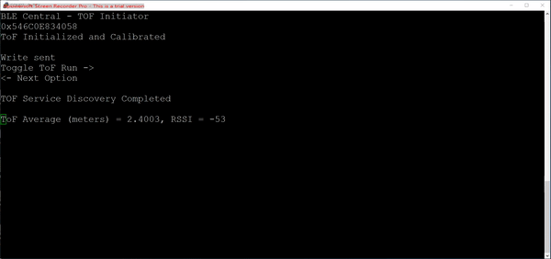
Updates on Location Detection
@ 3m

Slide 8

Updates on Location Detection
@2m

Slide 9

Updates on Location Detection
@ 6m

Slide 10
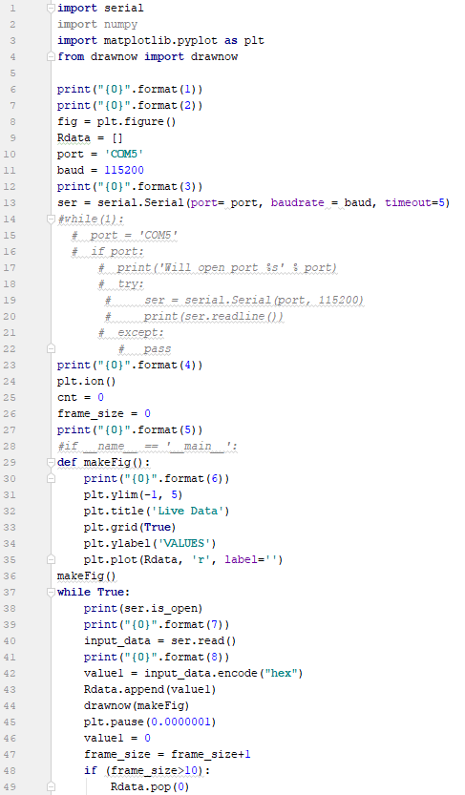
Progress on Code
The definition function in Python code was unreachable, causing error
To fix this, the line makeFig() was added telling python to enter the definition

Slide 11
Code Debugging
The information send to the BlueSMiRF from the MSP is not correct, causing the BlueSMiRF to output undefined characters which Python cannot interpret
Further debugging will be done to fix this error, which could be due to the MSP's buffer size, or a mismatch in actual baud rate

Slide 12
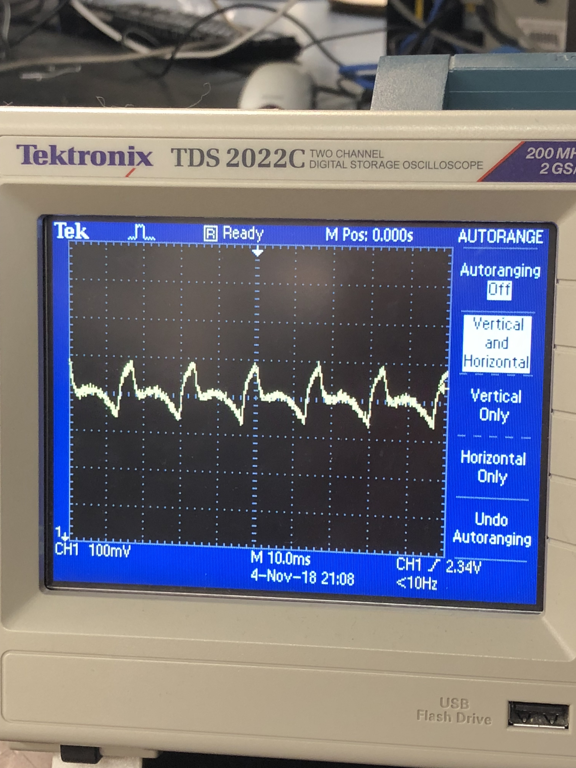
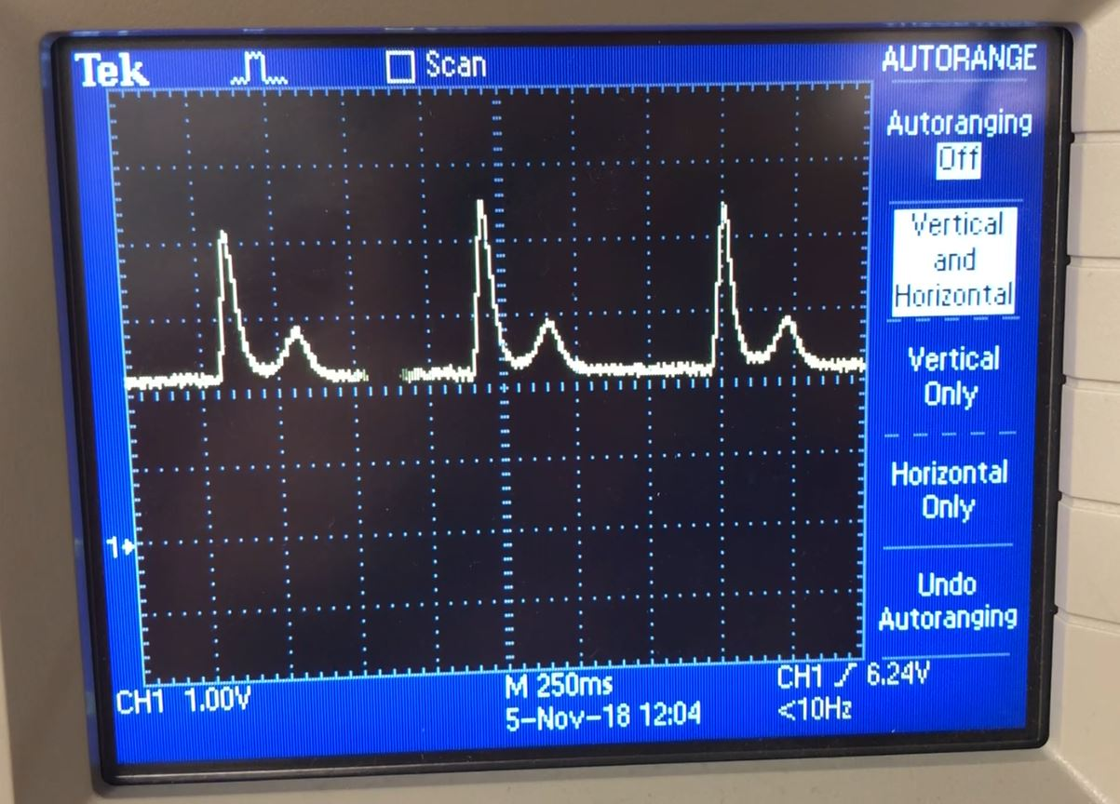
Circuitry
With heavy artifact
Without heavy artifact

Slide 13
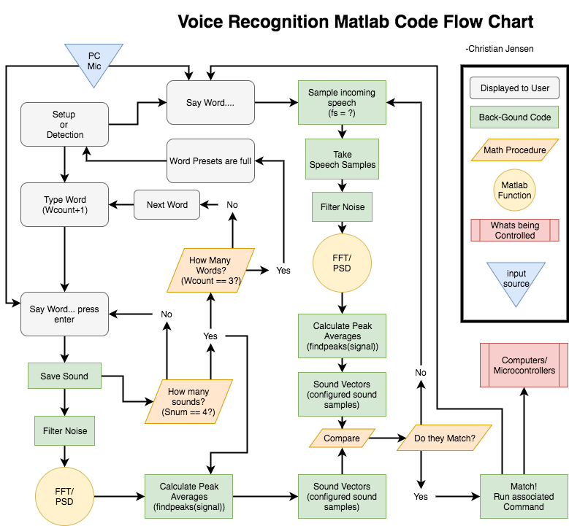

Slide 14
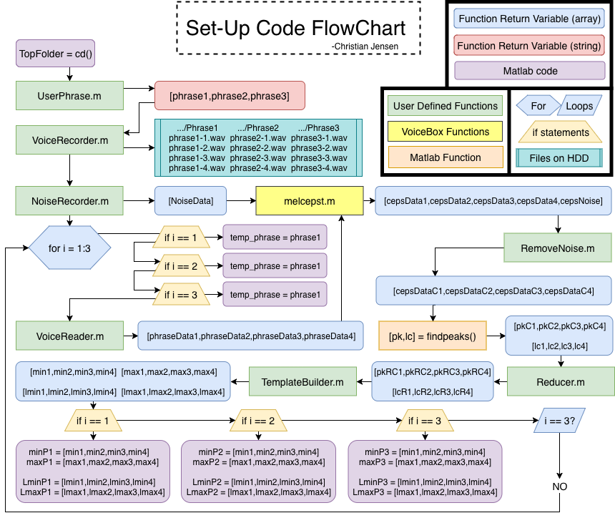

Slide 15
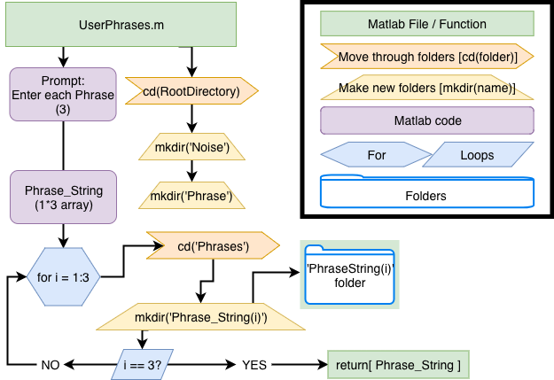

Slide 16
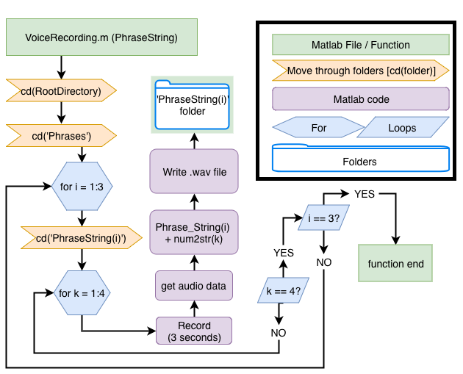

Slide 17
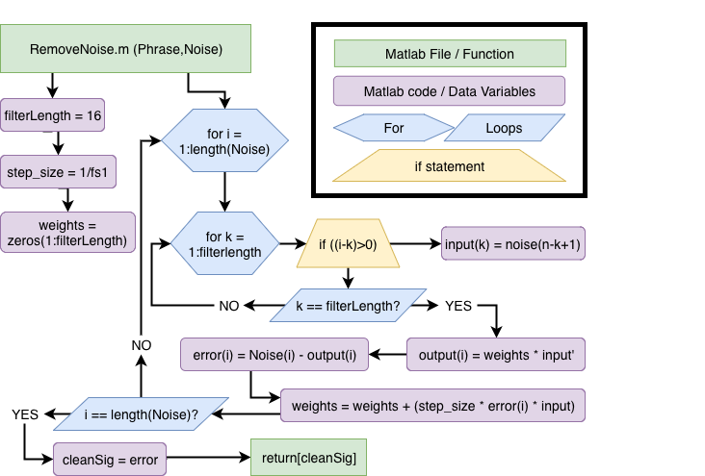
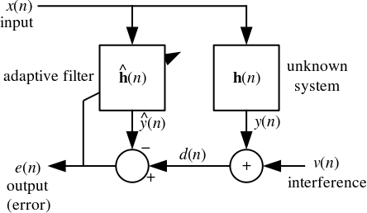
Least Mean Squared adaptive filter

Slide 18
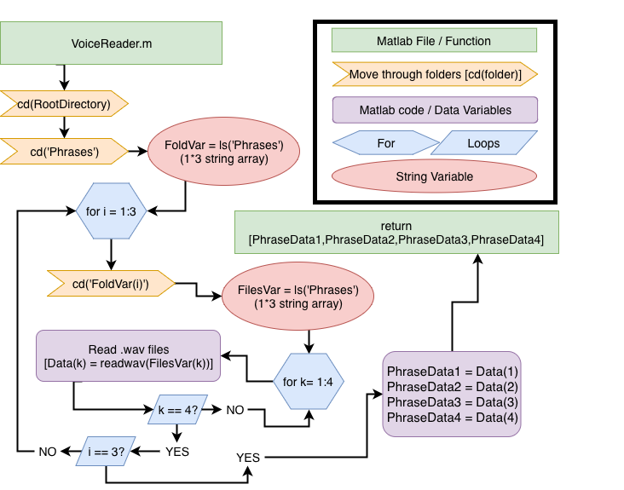

Slide 19
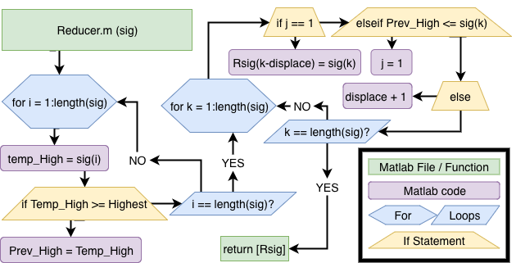
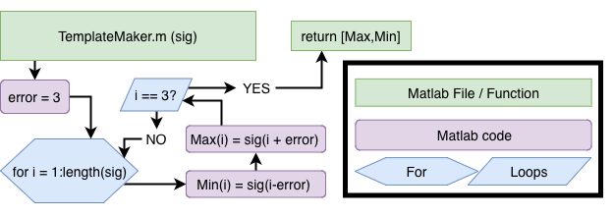

Slide 20
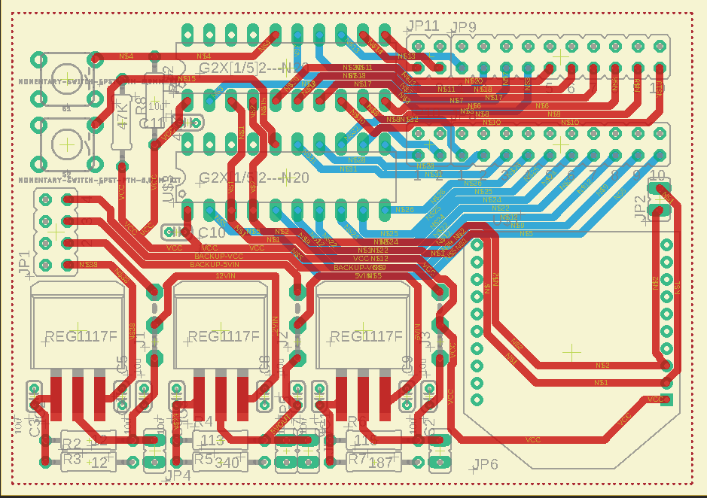
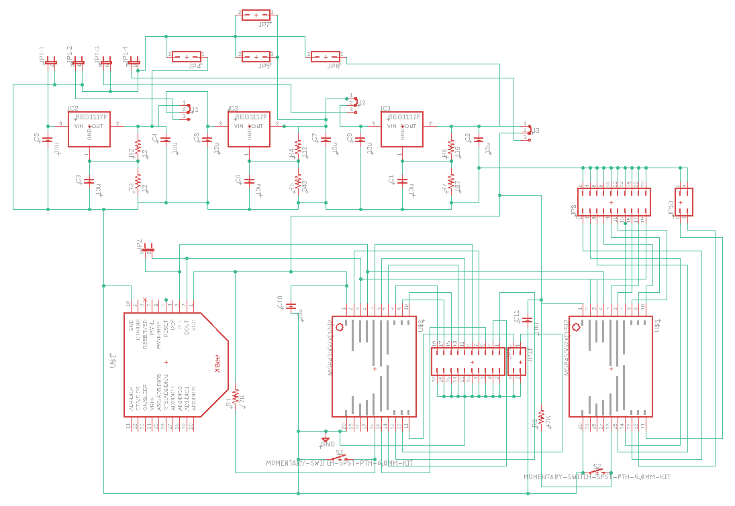
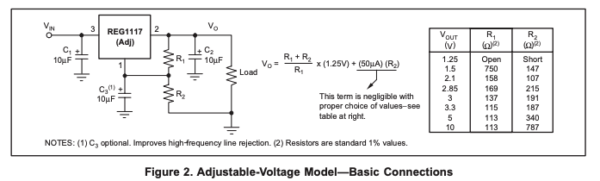
Green Board Design
2 MSP paired with an XBee Module
2x MSP430G IC
3x regulators
All REG1117 adjustable LDOs [1]
1 A output (max)
3.3V,5V,12V
XBee Module on header pins
Design done in Eagle Cad

Slide 21
Update
Was able to establish serial communication using XBee module
When authorized user is detected "door open" is send to COM8 port
When unknown user is detected "door close" is send to COM8 port
COM8 port is set as my coordinator module which will pass this information to Router module (connected to motor to open door)
Modified face detector code to implement these changes
Next week's plan
NEMA 17 SM-42BYG011-25 bipolar stepper motor will be used to open the door
Will be coding to detect RX pin of Router module to send signal to the stepper motor

Slide 22
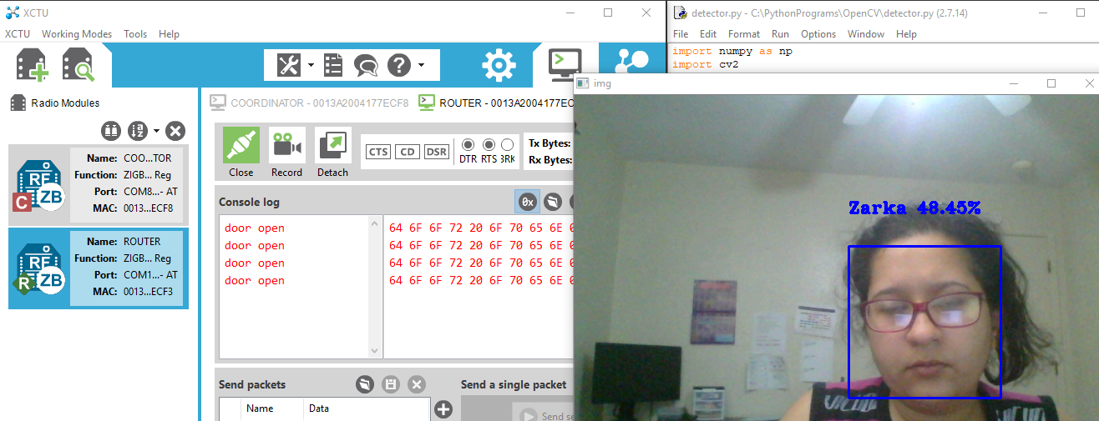
Door open

Slide 23
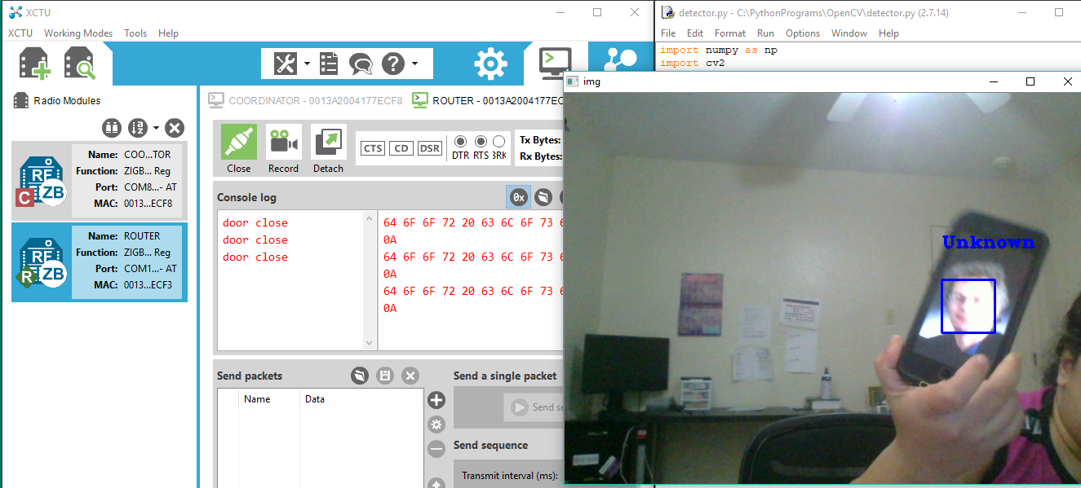
Door close

Slide 24
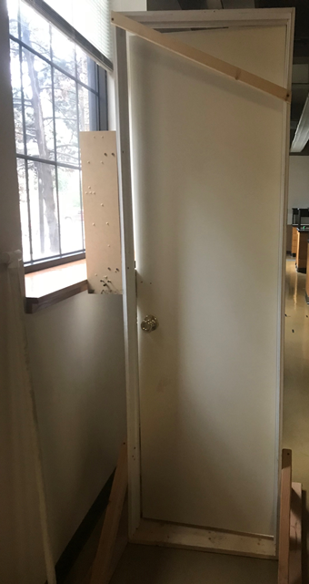
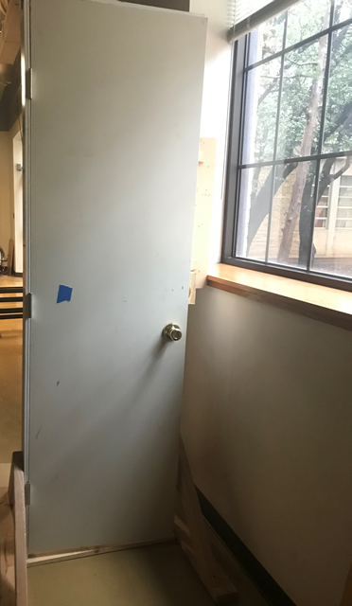
Opening door concept
Motor on one side with a string attached to a nail
Stepper Motor

Slide 25
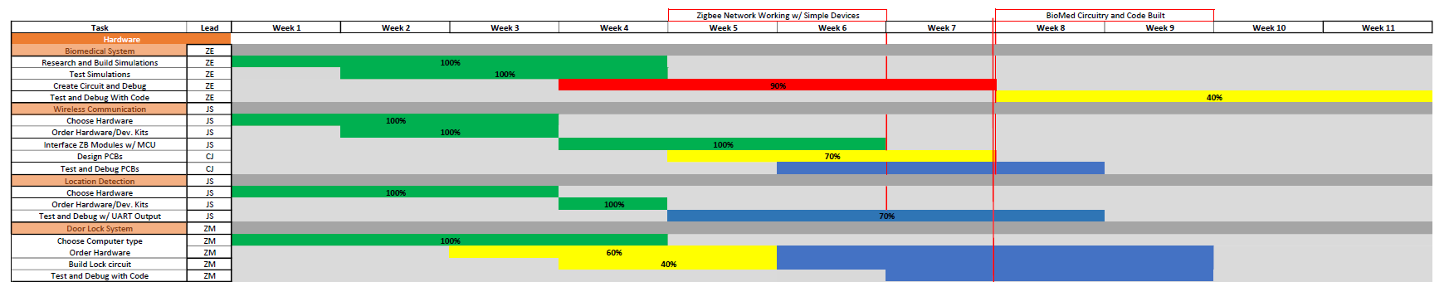
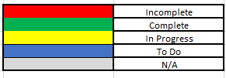
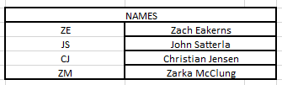
Gantt Chart

Slide 26
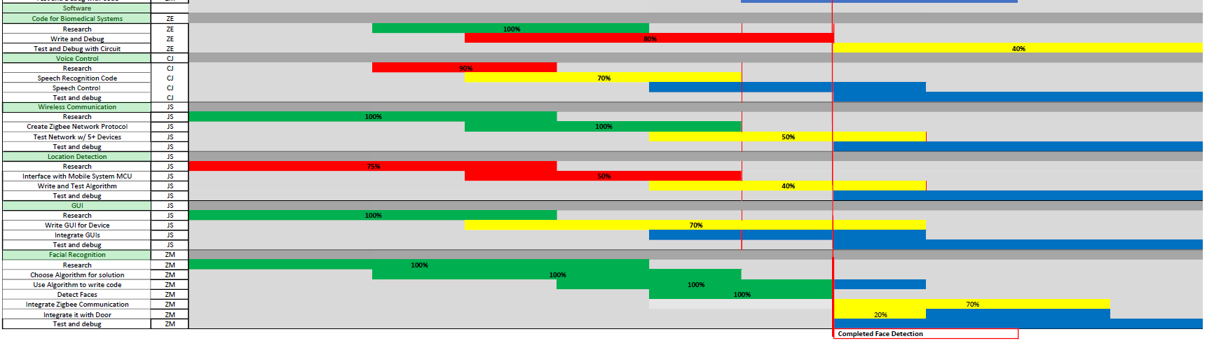
Gantt Chart

Slide 27
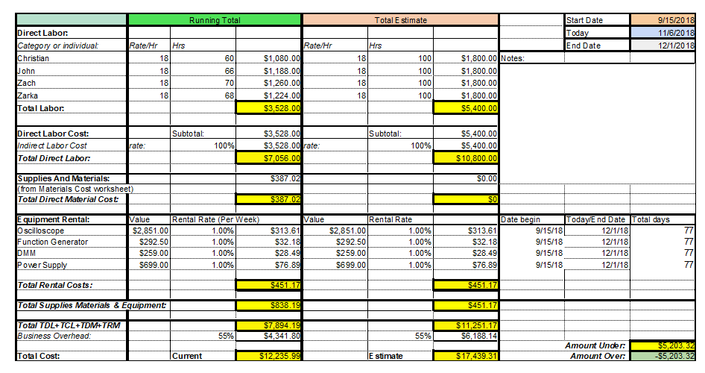
Budget

Slide 28
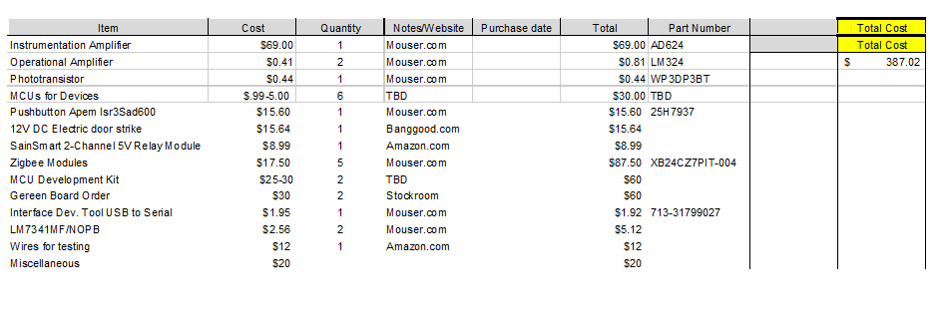
Material Cost

Slide 29
Next Week's Deliverables
John Satterla
Zachary Eakerns
Zarka McClung
Christian Jensen
Start integrating GUI's
Start interfacing devices
Improve accuracy of location detection
Have python graphing the ADC in real time
Establish motor code upon signal from Zigbee coordinator
Finalize code for MATLAB serial communication
Order green board

Slide 30
References
“REG1117A (ACTIVE),” REG1117A 1A Low Dropout Positive Regulator | TI.com. [Online]. Available: http://www.ti.com/product/REG1117A. [Accessed: 07-Nov-2018].

Slide 31
Questions?

